Slide 1
Image Processing
Lab 5
Timo Wang

Slide 2
Morphological Operations
Morphological operations use a structuring element to analyze the geometrical properties of an image.
These operations can be used for tasks such as noise reduction, edge detection, and image enhancement.

Slide 3
Morphological Operations
Dilation is an operation that involves expanding and thickening the shapes in an image. This is achieved by adding pixels to the boundaries of objects in an image. The result is that the objects in the image become larger and more pronounced.
Erosion, on the other hand, involves shrinking and thinning the shapes in an image. This is achieved by removing pixels from the boundaries of objects in an image. The result is that the objects in the image become smaller and less pronounced.
Opening is a combination of erosion followed by dilation. It is used to remove small objects from an image while preserving the larger objects. This operation is useful in removing noise from an image.
Closing is a combination of dilation followed by erosion. It is used to fill small holes or gaps in an image while preserving the overall shape of the objects in the image. This operation is useful in smoothing out the objects in an image.

Slide 4
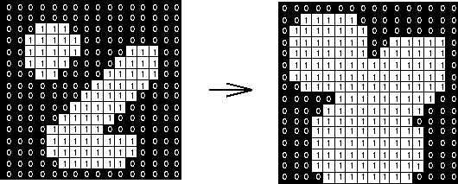
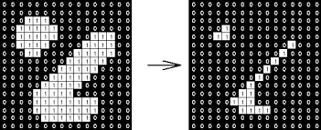
Dilation
Erosion

Slide 5
Examples
import matplotlib.pyplot as plt
from skimage import morphology, data
# Load image
image = data.coins()
# Define structuring element
selem = morphology.square(3)
# Apply dilation operation to image
dilated_image = morphology.dilation(image, selem)
# Display original and dilated images
fig, axes = plt.subplots(nrows=1, ncols=2, figsize=(8, 4))
ax = axes.ravel()
ax[0].imshow(image, cmap='gray‘)
ax[0].set_title('Original‘)
ax[1].imshow(dilated_image, cmap='gray‘)
ax[1].set_title('Dilated‘)
plt.show()

Slide 6
Object Detection
Object detection is an essential field in computer vision that involves locating and identifying objects in images or videos.
Object detection has numerous applications in various industries, such as self-driving cars, security systems, and robotics. It enables machines to interact with their environment by recognizing and localizing specific objects of interest.
One of the most popular object detection algorithms is the Haar Cascade Classifier, which is a machine learning-based approach that uses features such as edges, lines, and textures to detect objects. It is commonly used for face detection, but it can also be trained to detect other objects such as cars, animals, and buildings.
One of the advantages of the Haar Cascade Classifier is its speed. It can detect objects in real-time and is often used in applications that require fast image processing, such as surveillance systems and driver assistance technologies.
https://medium.com/analytics-vidhya/haar-cascades-explained-38210e57970d
https://towardsdatascience.com/face-detection-with-haar-cascade-727f68dafd08

Slide 7
Examples
import os
import cv2
import matplotlib.pyplot as plt
def detect(image_name):
# Load image and cascade classifier
img = cv2.imread(image_name)
plate_cascade = cv2.CascadeClassifier('haarcascade_russian_plate_number.xml')
# Convert image to grayscale
gray = cv2.cvtColor(img, cv2.COLOR_BGR2GRAY)
# Detect license plates in image
plates = plate_cascade.detectMultiScale(gray, scaleFactor=1.1, minNeighbors=5)
# Draw bounding boxes around license plates
for (x, y, w, h) in plates:
cv2.rectangle(img, (x, y), (x+w, y+h), (0, 255, 0), 2)
# Display image with bounding boxes
plt.imshow(img)
detect(os.path.abspath("cars1.jpeg"))

